Slide 1

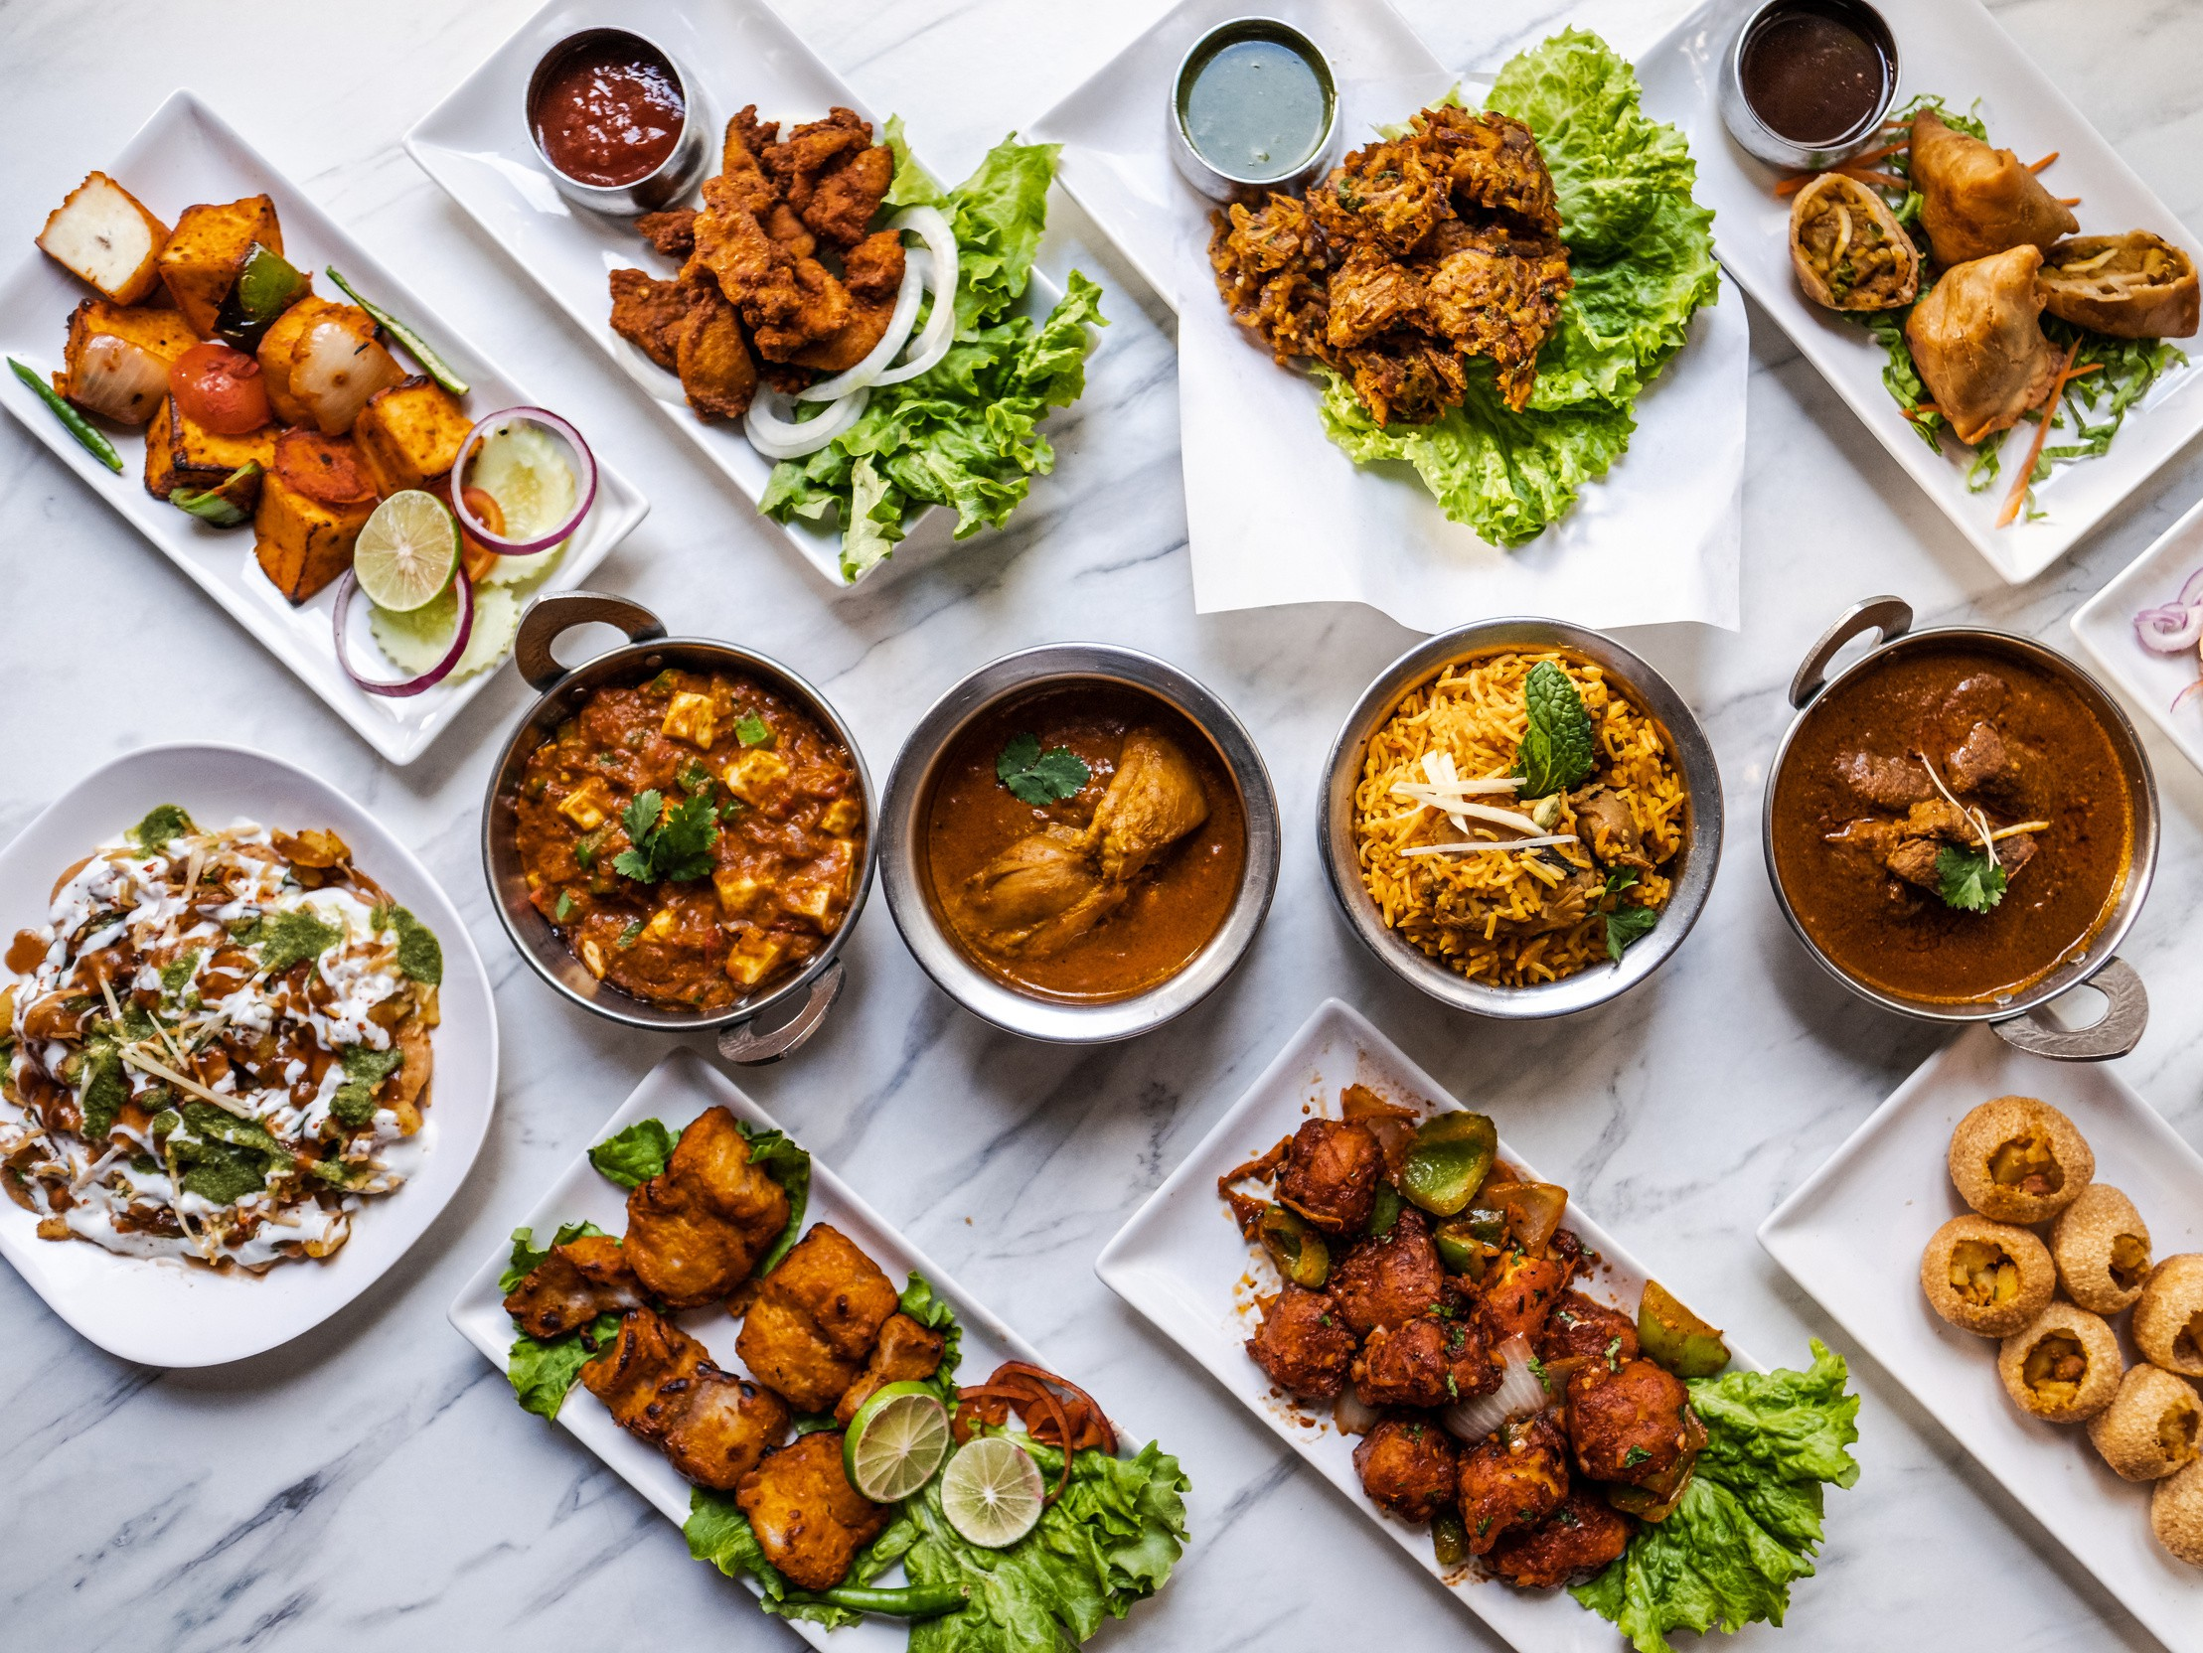

Analysis of Food and Beverage Industry Survey Data
Insights and Recommendations
Rituparna Swain
; Data Analyst

Slide 2

Introduction
My name is Rituparna, and I am currently pursuing a Data Analyst course. I am excited to share my project on the Analysis of Food and Beverage Industry Survey Data using Power BI. This project provides a comprehensive overview of consumer behavior and preferences within the food and beverage sector.
The survey data includes responses from 10,000 participants, offering insights into brand awareness, health consciousness, consumption frequency, and demographic distribution. Key findings reveal that 73% of respondents are aware of the brands surveyed, but only 6% are health-conscious, indicating a market opportunity for healthier options. The majority of respondents are aged 19-30 years, showing a young and dynamic consumer base.
City-wise consumption patterns vary, with some cities showing higher daily consumption rates and a preference for natural or organic products. Popular brands among respondents include Bepsi, Blue Bull, Codex, and Cola-Coka. Health concerns are significant for many respondents, with a preference for products with natural ingredients and reduced sugar content. Additionally, price sensitivity varies, with a notable segment willing to pay a premium for quality and health benefits.
This analysis provides valuable insights into consumer behavior and preferences, helping businesses tailor their⁰³strategies to better meet consumer needs.

Slide 3
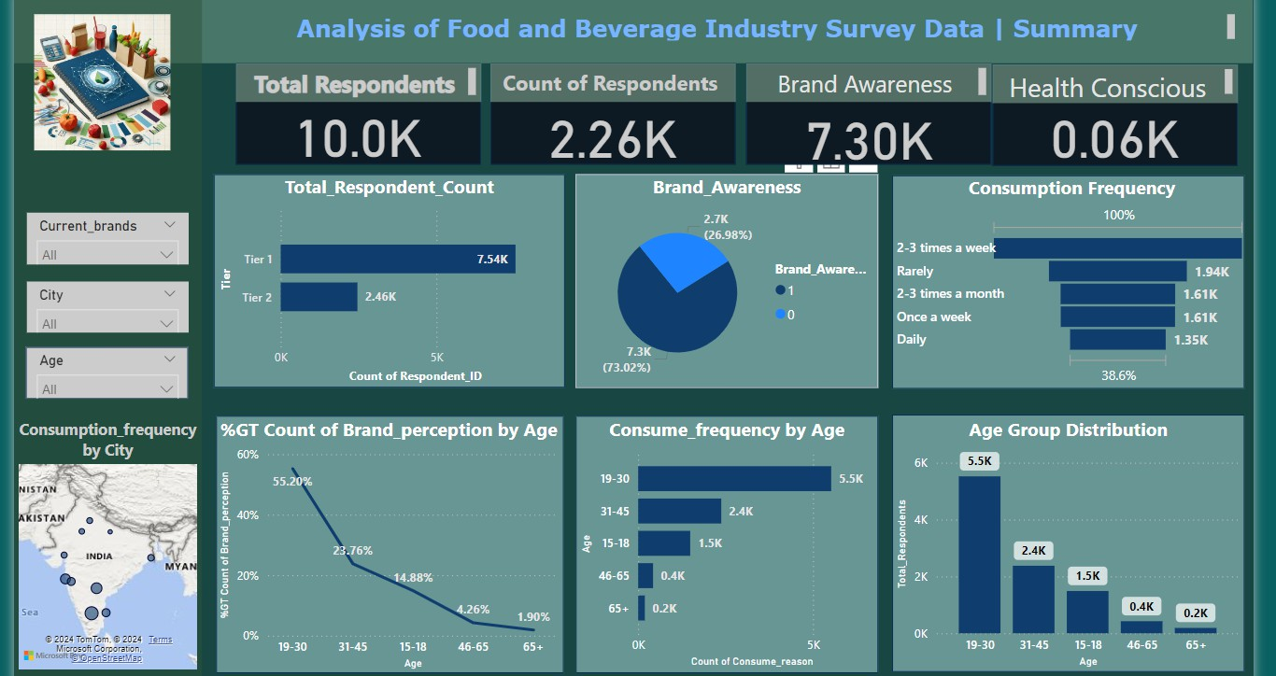

Slide 4
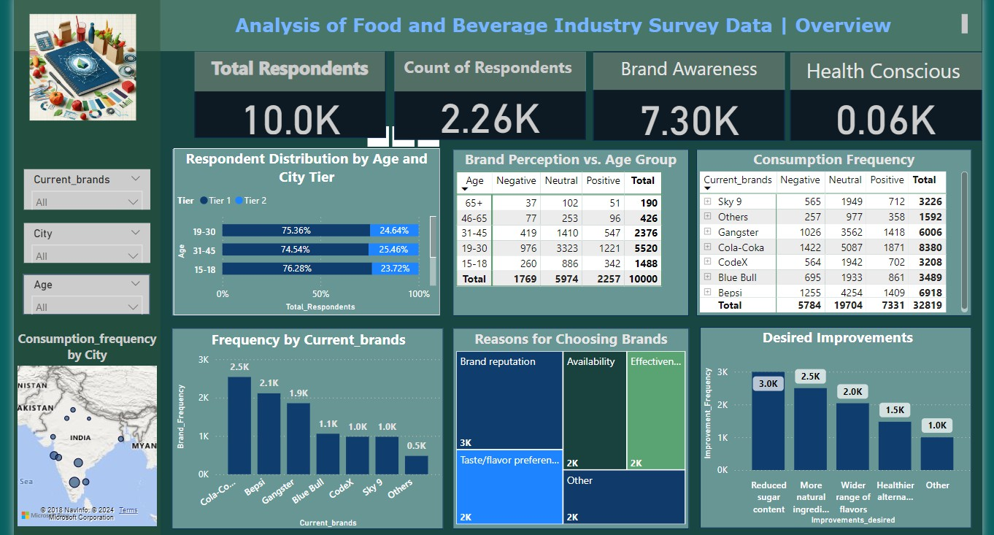

Slide 5
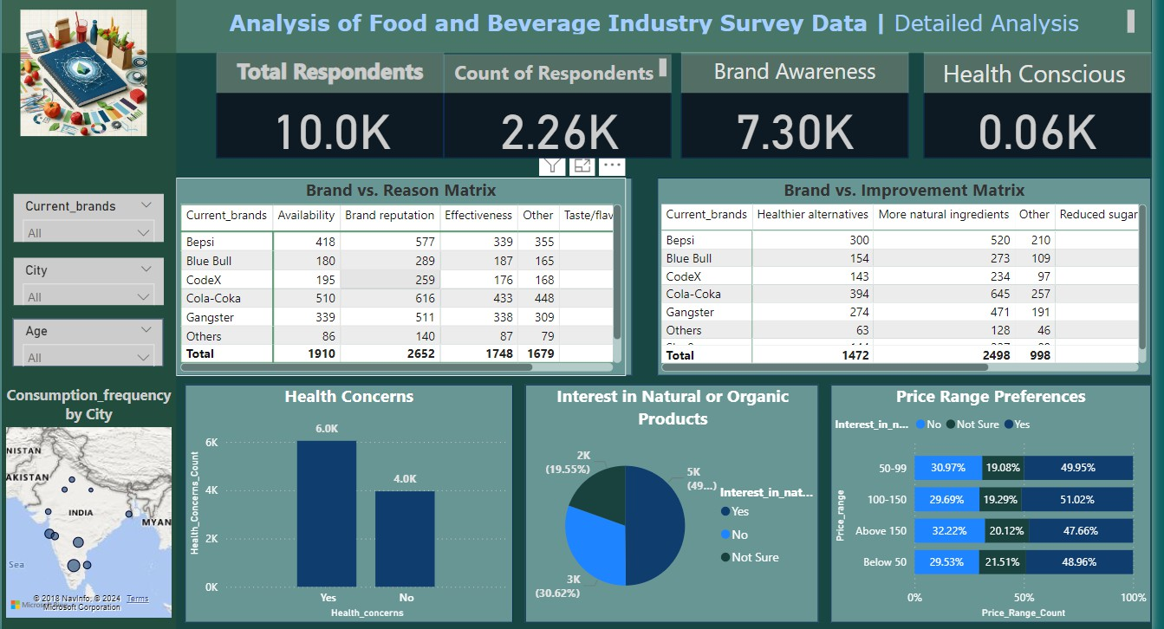

Slide 6
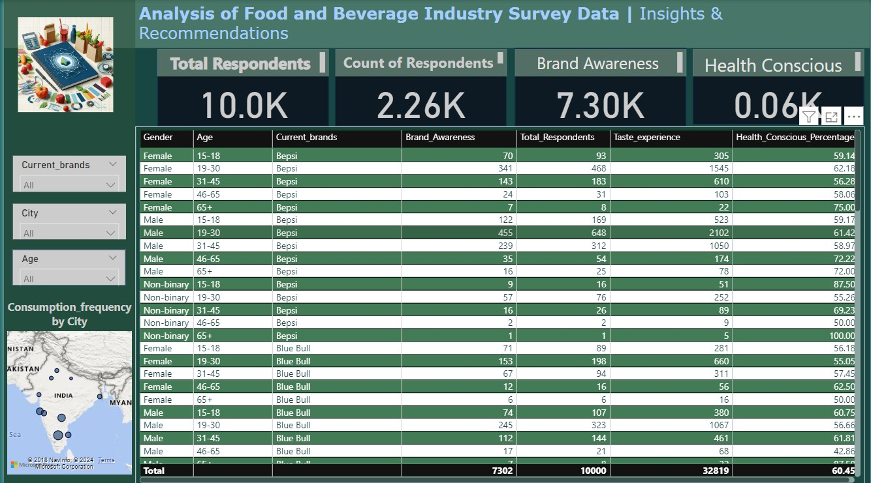

Slide 7

BRAND PREFERENCE
Bepsi: Popular among younger respondents, especially in the 15-30 age group.
Blue Bull: Preferred by respondents across all age groups, with a strong presence in urban areas.
Codex: Shows a balanced preference across different age groups, with a slight inclination towards older respondents.
Cola-Coka: Highly popular among the 19-
30 age group, with a strong brand reputation.

Slide 8

Gender Distribution:
Female Respondents: A significant portion of the respondents are female, with notable brand awareness and health consciousness.
Male Respondents: Male respondents also show high brand awareness, but slightly lower health consciousness compared to females.
Non-binary Respondents: This group, though smaller in number, shows a high level of health consciousness.

Slide 9

Age Group Insights
15-18 Years: This age group shows a strong preference for trendy brands and is less health-conscious.
19-30 Years: The largest age group, showing a balanced interest in brand reputation and health-conscious products.
31-45 Years: This group values brand reputation and effectiveness, with a moderate interest in health-conscious products.
46-65 Years: Smaller in number but highly health-conscious, preferring brands with healthier alternatives.

Slide 10


City-wise Consumption
The data highlights varying consumption patterns across different cities, with some cities showing higher daily consumption rates.
Cities with higher health consciousness also show a preference for natural or organic products.
Health Concerns
A significant portion of respondents are concerned about health, with a preference for products with natural ingredients and reduced sugar content.
Health-conscious respondents are more likely to choose brands that offer healthier alternatives.

Slide 11

Price Sensitivity
Respondents show varied price sensitivity, with a notable segment willing to pay a premium for quality and health benefits.
Price preferences also vary by age group and city, indicating the need for targeted pricing strategies.

Slide 12
Conclusion
The survey data from 10,000 respondents offers valuable insights into the food and beverage industry. Key findings include strong brand awareness and varied consumption patterns, with a significant portion of respondents consuming products daily or several times a week. The majority of respondents are young, aged 19-30 years, indicating a dynamic consumer base. Health consciousness is relatively low, presenting an opportunity for brands to introduce healthier options. City-wise consumption patterns and brand preferences highlight the need for targeted marketing strategies. Additionally, there is a notable segment of respondents willing to pay a premium for quality and health benefits.
These insights suggest that businesses should focus on increasing health-conscious product offerings, tailoring marketing strategies to specific demographics, and considering premium product lines to cater to quality-conscious consumers. By understanding these trends, businesses can better meet consumer needs and drive growth in the market.

Slide 13
Thank You

